Slide 1
1. Basic math Linear algebra

Slide 2
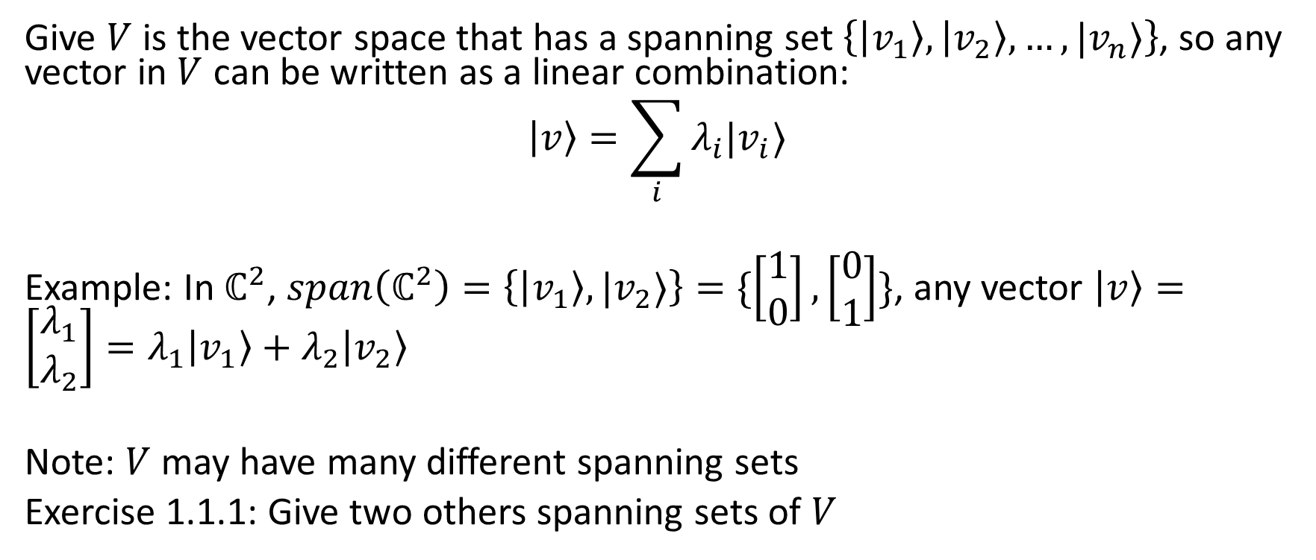
1.1. Bases, Linear independence
Give $V$ is the vector space that has a spanning set $\left\{\left|v_{1}\right\rangle ,\left|v_{2}\right\rangle ,…,|v_{n}⟩\right\}$, so any vector in $V$ can be written as a linear combination:
$$\left|v\right\rangle =\sum_{i}{λ_{i}|v_{i}⟩}$$
Example: In $ℂ^{2}$, $span\left(ℂ^{2}\right)=\left\{\left|v_{1}\right\rangle ,|v_{2}⟩\right\}=\{\left[\begin{matrix}1 \\ 0\end{matrix}\right],\left[\begin{matrix}0 \\ 1\end{matrix}\right]\}$, any vector $\left|v\right\rangle =\left[\begin{matrix}λ_{1} \\ λ_{2}\end{matrix}\right]=λ_{1}\left|v_{1}\right\rangle +λ_{2}\left|v_{2}\right\rangle$
Note: $V$ may have many different spanning sets
Exercise 1.1.1: Give two others spanning sets of $V$

Slide 3
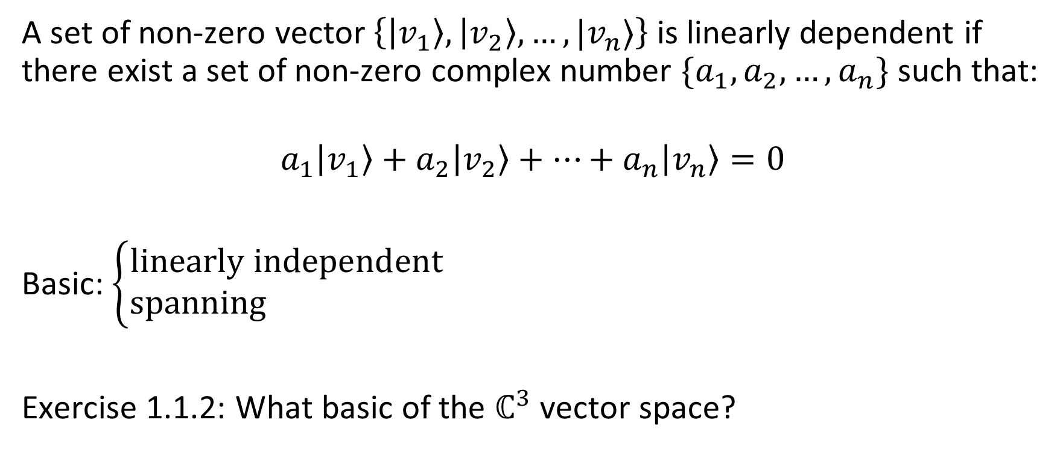
1.1. Bases, Linear independence
A set of non-zero vector$\left\{\left|v_{1}\right\rangle ,\left|v_{2}\right\rangle ,…,|v_{n}⟩\right\}$ is linearly dependent if there exist a set of non-zero complex number $\{a_{1},a_{2},…,a_{n}\}$ such that:
$$a_{1}\left|v_{1}\right\rangle +a_{2}\left|v_{2}\right\rangle +…+a_{n}\left|v_{n}\right\rangle =0$$
Basic: $\left\{\begin{aligned}linearly independent \\ spanning \end{aligned}\right.$
Exercise 1.1.2: What basic of the $ℂ^{3}$ vector space?

Slide 4
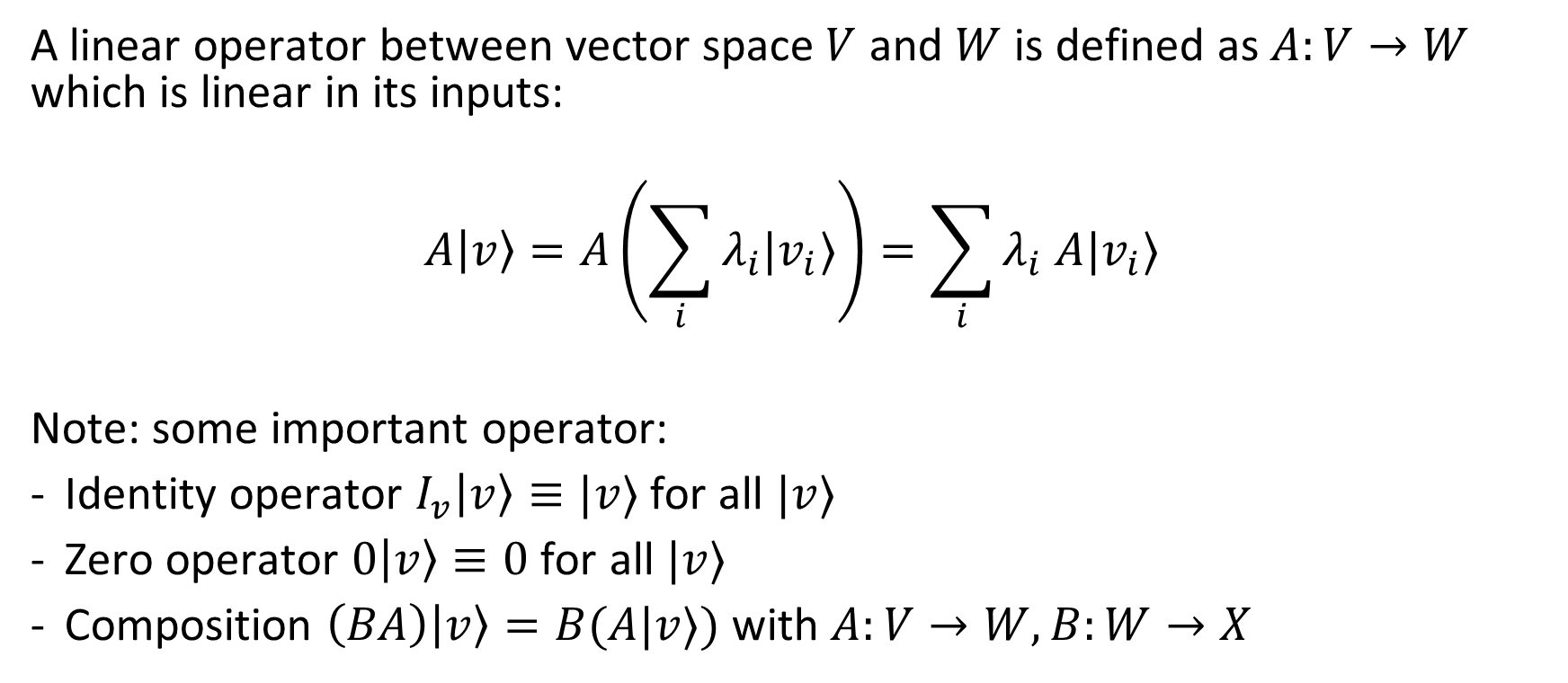
1.2. Linear operators and matrices
A linear operator between vector space $V$ and $W$ is defined as$A:V→W$ which is linear in its inputs:
$$A\left|v\right\rangle =A\left(\sum_{i}{λ_{i}|v_{i}⟩}\right)=\sum_{i}{λ_{i} A|v_{i}⟩}$$
Note: some important operator:
Identity operator $I_{v}\left|v\right\rangle ≡|v⟩$ for all $|v⟩$
Zero operator $0\left|v\right\rangle ≡0$ for all $|v⟩$
Composition $\left(BA\right)\left|v\right\rangle =B(A|v⟩)$ with $A:V→W,B:W→X$
Vector
Vector
Matrix

Slide 5
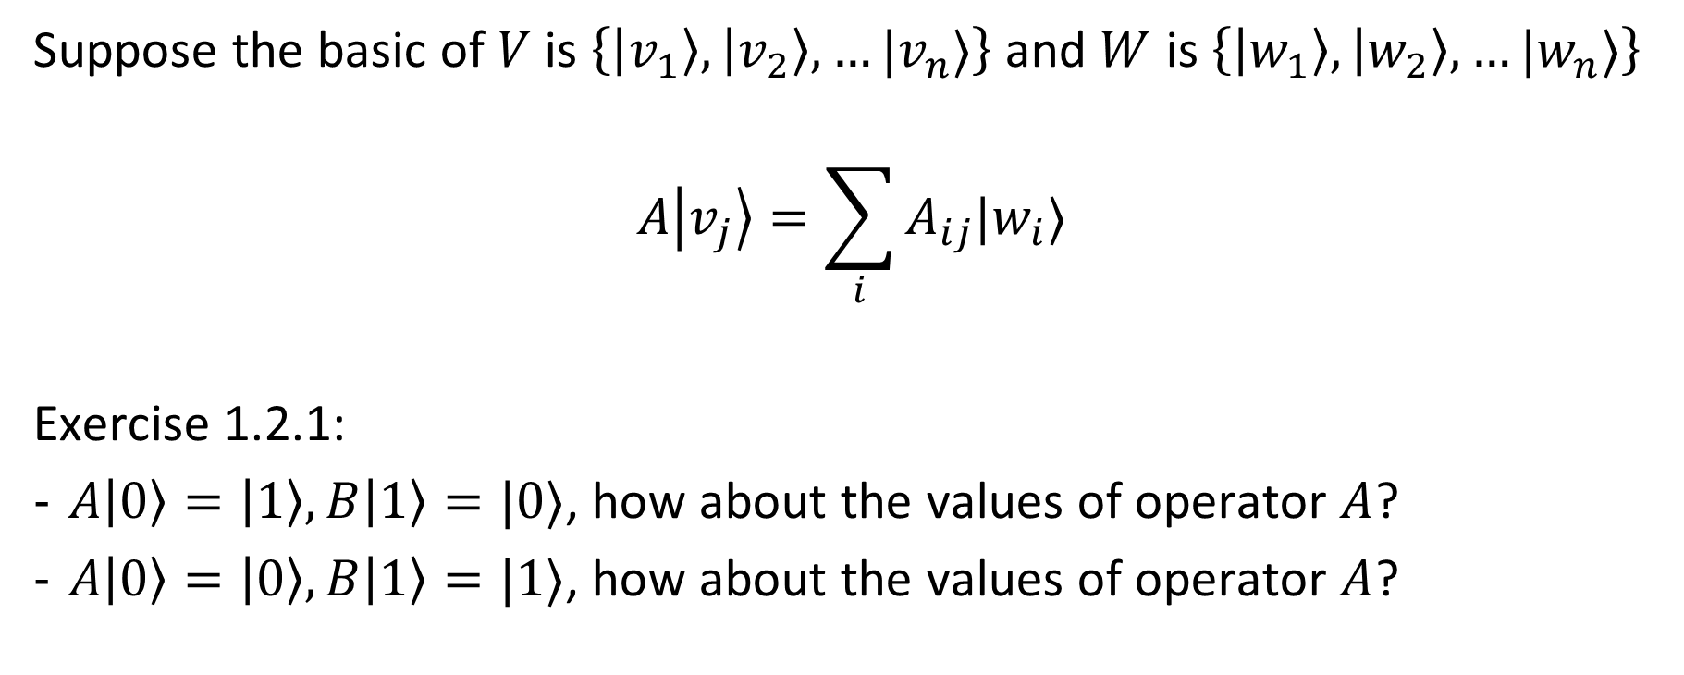
1.2. Linear operators and matrices
Suppose the basic of $V$ is $\left\{\left|v_{1}\right\rangle ,\left|v_{2}\right\rangle ,…|v_{n}⟩\right\}$ and $W$ is $\left\{\left|w_{1}\right\rangle ,\left|w_{2}\right\rangle ,…|w_{n}⟩\right\}$
$$A\left|v_{j}\right\rangle =\sum_{i}{A_{ij}|w_{i}⟩}$$
Exercise 1.2.1:
$A\left|0\right\rangle =\left|1\right\rangle ,B\left|1\right\rangle =|0⟩$, how about the values of operator $A$?
$A\left|0\right\rangle =\left|0\right\rangle ,B\left|1\right\rangle =|1⟩$, how about the values of operator $A$?
Vector
Vector
Scalar

Slide 6
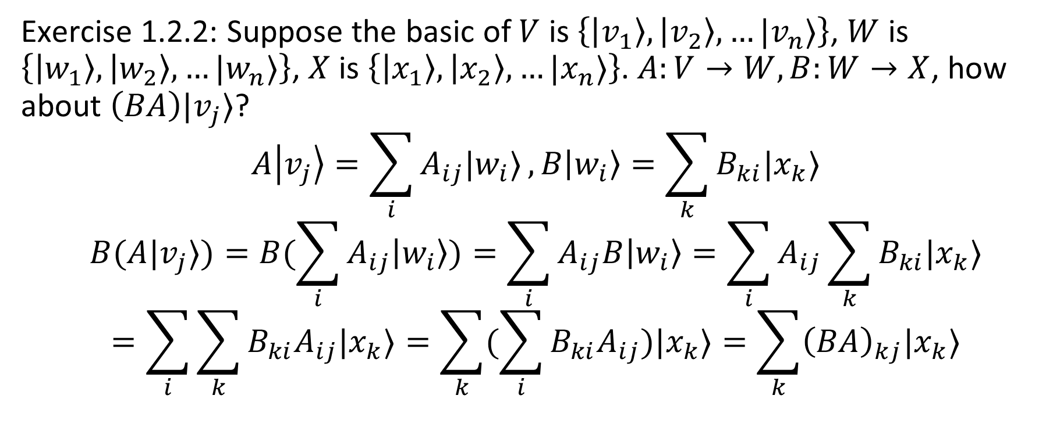
1.2. Linear operators and matrices
Exercise 1.2.2: Suppose the basic of $V$ is $\left\{\left|v_{1}\right\rangle ,\left|v_{2}\right\rangle ,…|v_{n}⟩\right\}$, $W$ is $\left\{\left|w_{1}\right\rangle ,\left|w_{2}\right\rangle ,…|w_{n}⟩\right\}$, $X$ is $\left\{\left|x_{1}\right\rangle ,\left|x_{2}\right\rangle ,…|x_{n}⟩\right\}$. $A:V→W,B:W→X$, how about $\left(BA\right)|v_{j}⟩$?
$$A\left|v_{j}\right\rangle =\sum_{i}{A_{ij}|w_{i}⟩},B\left|w_{i}\right\rangle =\sum_{k}{B_{ki}|x_{k}⟩}$$
$$B(A|v_{j}⟩)=B(\sum_{i}{A_{ij}\left|w_{i}\right\rangle })=\sum_{i}{A_{ij}B\left|w_{i}\right\rangle =\sum_{i}{A_{ij}\sum_{k}{B_{ki}|x_{k}⟩}}}$$
$$=\sum_{i}{\sum_{k}{B_{ki}A_{ij}|x_{k}⟩}=\sum_{k}{(\sum_{i}{B_{ki}A_{ij}})|x_{k}⟩}}=\sum_{k}{{\left(BA\right)}_{kj}|x_{k}⟩}$$

Slide 7

1.3. Pauli matrices
$$σ_{0}=I=\left[\begin{matrix}1 & 0 \\ 0 & 1\end{matrix}\right]$$
$$σ_{1}=σ_{x}=X=\left[\begin{matrix}0 & 1 \\ 1 & 0\end{matrix}\right]$$
$$σ_{2}=σ_{y}=Y=\left[\begin{matrix}0 & −i \\ i & 0\end{matrix}\right]$$
$$σ_{3}=σ_{z}=Z=\left[\begin{matrix}1 & 0 \\ 0 & −1\end{matrix}\right]$$

Slide 8
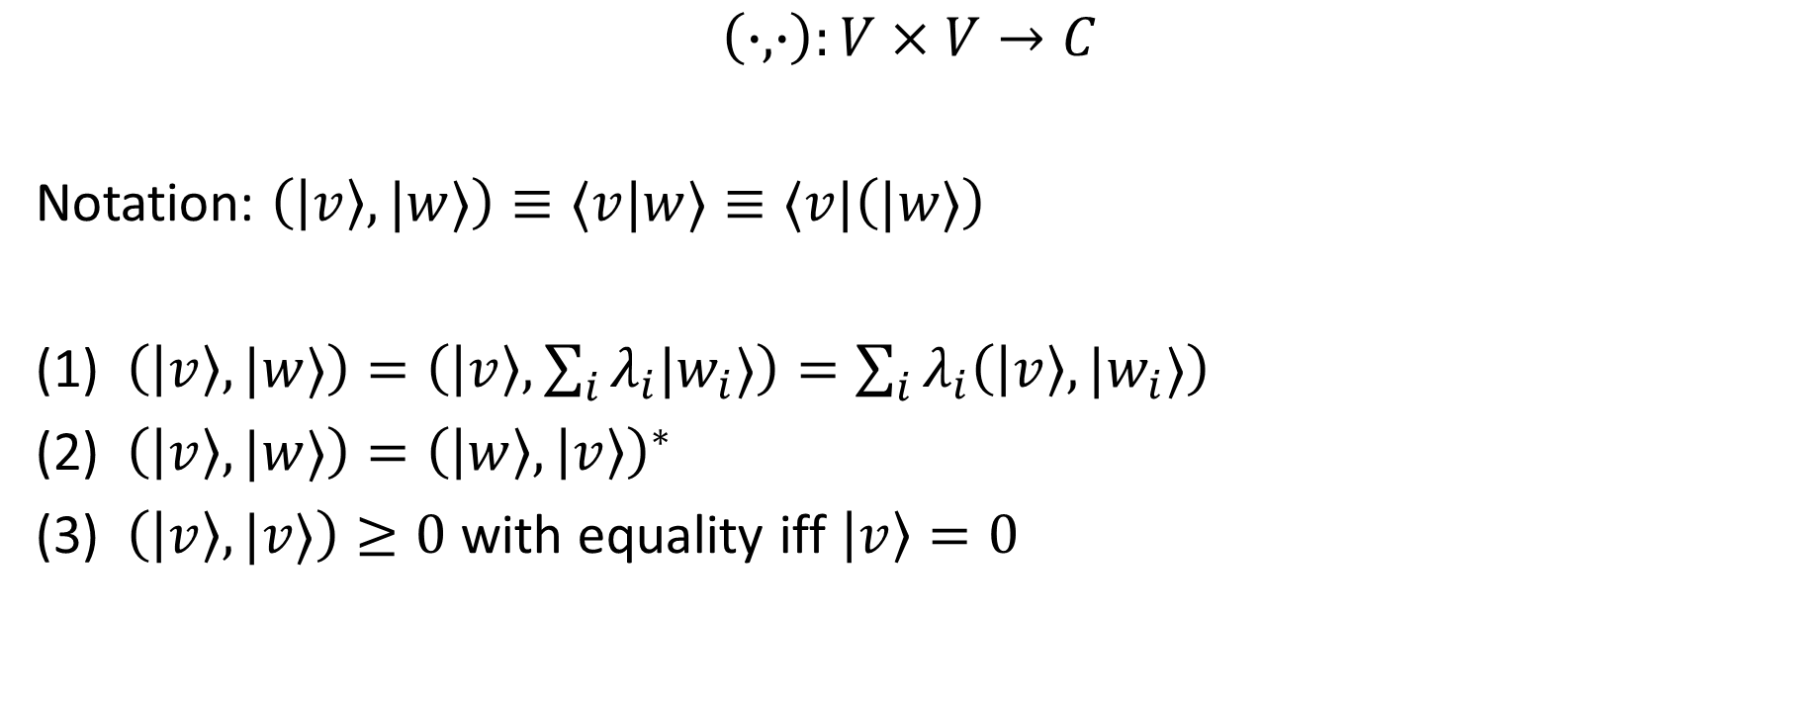
1.4. Inner product
$$\left(∙,∙\right):V×V→C$$
Notation: $\left(\left|v\right\rangle ,|w⟩\right)≡⟨v|w⟩≡⟨v|\left(|w⟩\right)$
(1) $\left(\left|v\right\rangle ,|w⟩\right)=\left(\left|v\right\rangle ,\sum_{i}{λ_{i}|w_{i}⟩}\right)=\sum_{i}{λ_{i}\left(\left|v\right\rangle ,|w_{i}⟩\right) }$
(2) $\left(\left|v\right\rangle ,|w⟩\right)={\left(\left|w\right\rangle ,\left|v\right\rangle \right)}^{∗}$
(3) $\left(\left|v\right\rangle ,|v⟩\right)≥0$ with equality iff $\left|v\right\rangle =0$

Slide 9
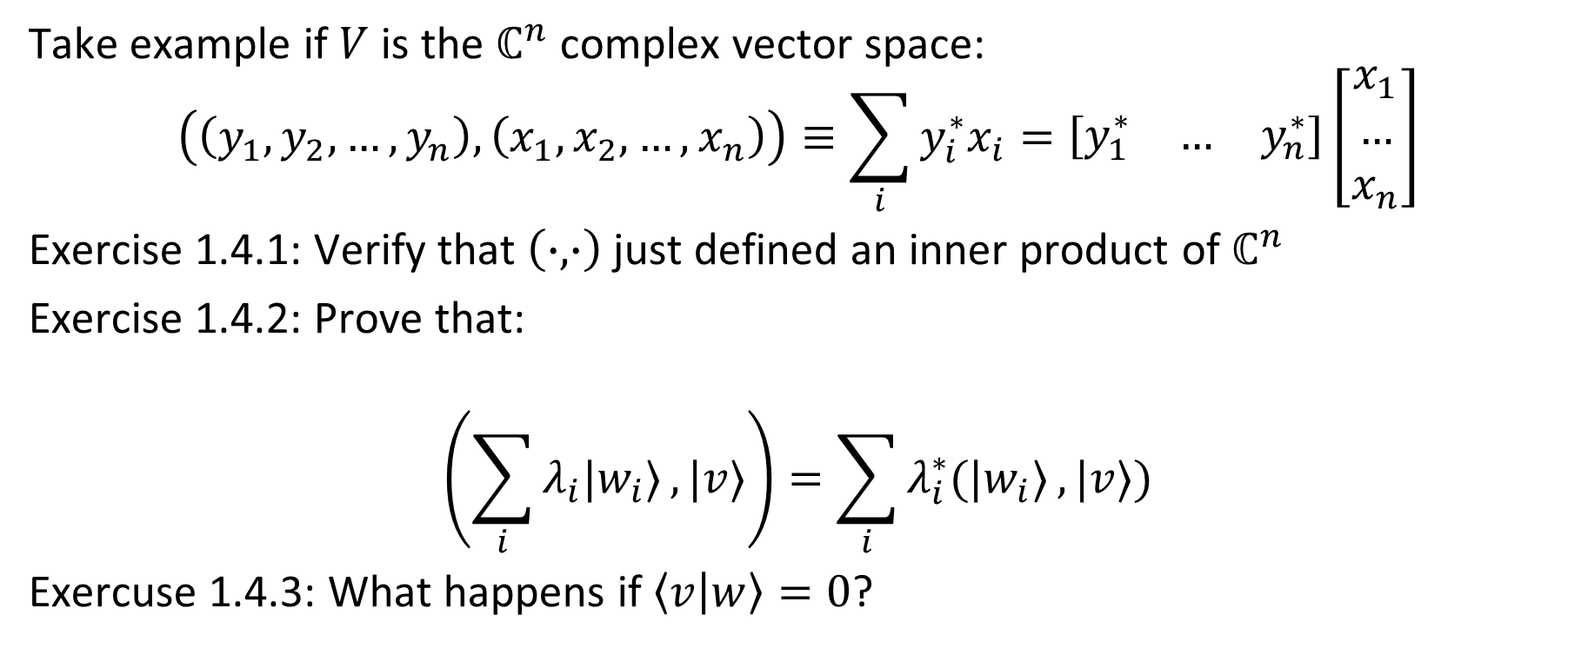
1.4. Inner product
Take example if $V$ is the $ℂ^{n}$ complex vector space:
$$\left(\left(y_{1},y_{2},…,y_{n}\right), \left(x_{1},x_{2},…,x_{n}\right)\right)≡\sum_{i}{y_{i}^{∗}x_{i}}=\left[\begin{matrix}y_{1}^{∗} & … & y_{n}^{∗}\end{matrix}\right]\left[\begin{matrix}x_{1} \\ … \\ x_{n}\end{matrix}\right]$$
Exercise 1.4.1: Verify that $\left(∙,∙\right)$ just defined an inner product of $ℂ^{n}$
Exercise 1.4.2: Prove that:
$$\left(\sum_{i}{λ_{i}|w_{i}⟩}, |v⟩\right)=\sum_{i}{λ_{i}^{∗}(|w_{i}⟩}, |v⟩)$$
Exercuse 1.4.3: What happens if $\left\langle v | w\right\rangle =0$?

Slide 10
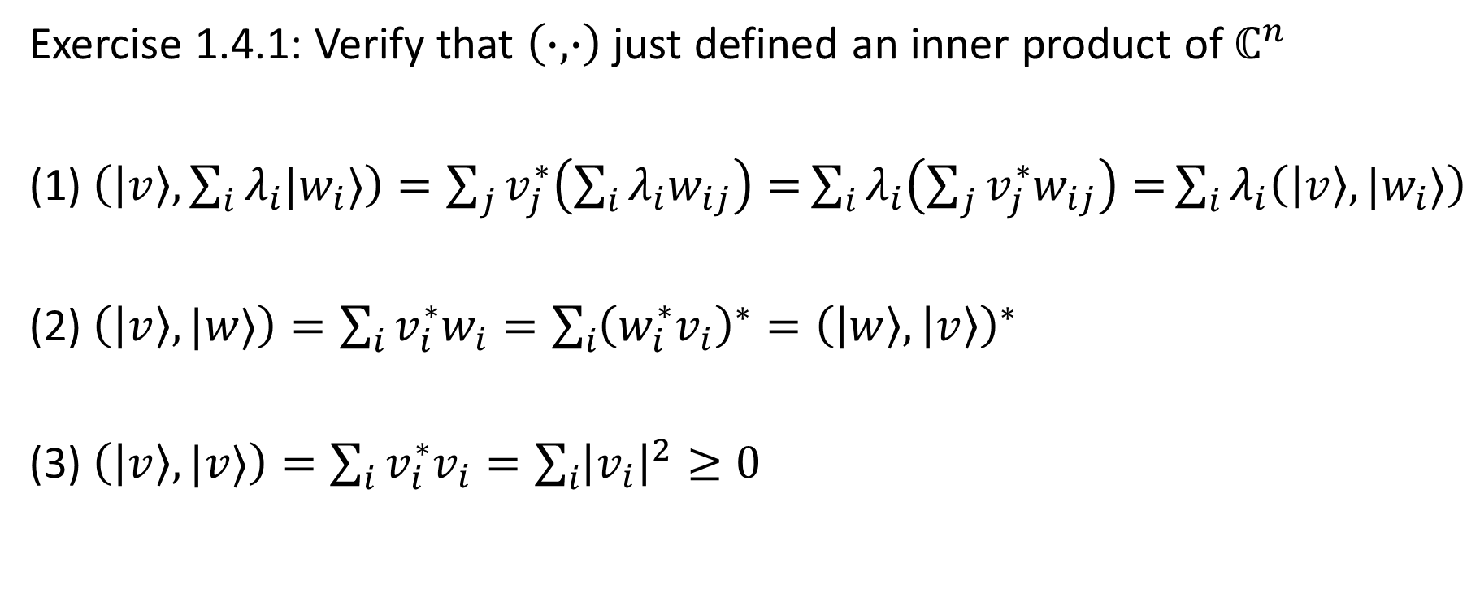
1.4. Inner product
Exercise 1.4.1: Verify that $\left(∙,∙\right)$ just defined an inner product of $ℂ^{n}$
(1) $\left(\left|v\right\rangle ,\sum_{i}{λ_{i}|w_{i}⟩}\right)=\sum_{j}{v_{j}^{∗}\left(\sum_{i}{λ_{i}w_{ij}}\right)=}\sum_{i}{λ_{i}\left(\sum_{j}{v_{j}^{∗}w_{ij}}\right)=}\sum_{i}{λ_{i}\left(\left|v\right\rangle ,|w_{i}⟩\right)}$
(2) $\left(\left|v\right\rangle ,|w⟩\right)=\sum_{i}{v_{i}^{∗}w_{i}}=\sum_{i}{{\left(w_{i}^{∗}v_{i}\right)}^{∗}={\left(\left|w\right\rangle ,\left|v\right\rangle \right)}^{∗}}$
(3) $\left(\left|v\right\rangle ,|v⟩\right)=\sum_{i}{v_{i}^{∗}v_{i}=\sum_{i}{{\left|v_{i}\right|}^{2}≥0}}$

Slide 11
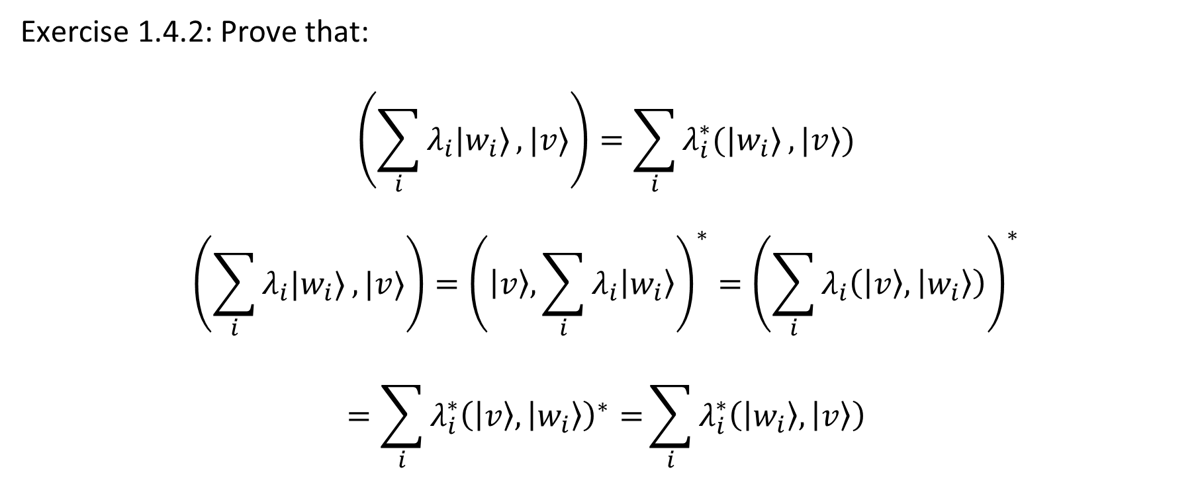
1.4. Inner product
Exercise 1.4.2: Prove that:
$$\left(\sum_{i}{λ_{i}|w_{i}⟩}, |v⟩\right)=\sum_{i}{λ_{i}^{∗}(|w_{i}⟩}, |v⟩)$$
$$\left(\sum_{i}{λ_{i}|w_{i}⟩}, |v⟩\right)={\left(\left|v\right\rangle ,\sum_{i}{λ_{i}\left|w_{i}\right\rangle }\right)}^{∗}={\left(\sum_{i}{λ_{i}\left(\left|v\right\rangle ,\left|w_{i}\right\rangle \right)}\right)}^{∗}$$
$$=\sum_{i}{λ_{i}^{∗}{\left(\left|v\right\rangle ,\left|w_{i}\right\rangle \right)}^{∗}=}\sum_{i}{λ_{i}^{∗}\left(\left|w_{i}\right\rangle ,\left|v\right\rangle \right)}$$

Slide 12

1.4. Inner product
Exercise 1.4.3: $|w⟩$ and $|v⟩$ are orthogonal if $\left\langle v | w\right\rangle =0$
Example:
$$\left|v\right\rangle =\left[\begin{matrix}1 \\ 0\end{matrix}\right],\left|w\right\rangle =\left[\begin{matrix}0 \\ 1\end{matrix}\right],\left\langle v | w\right\rangle =\left[\begin{matrix}1 & 0\end{matrix}\right]\left[\begin{matrix}0 \\ 1\end{matrix}\right]=0$$
(0, 1)
(1, 0)

Slide 13
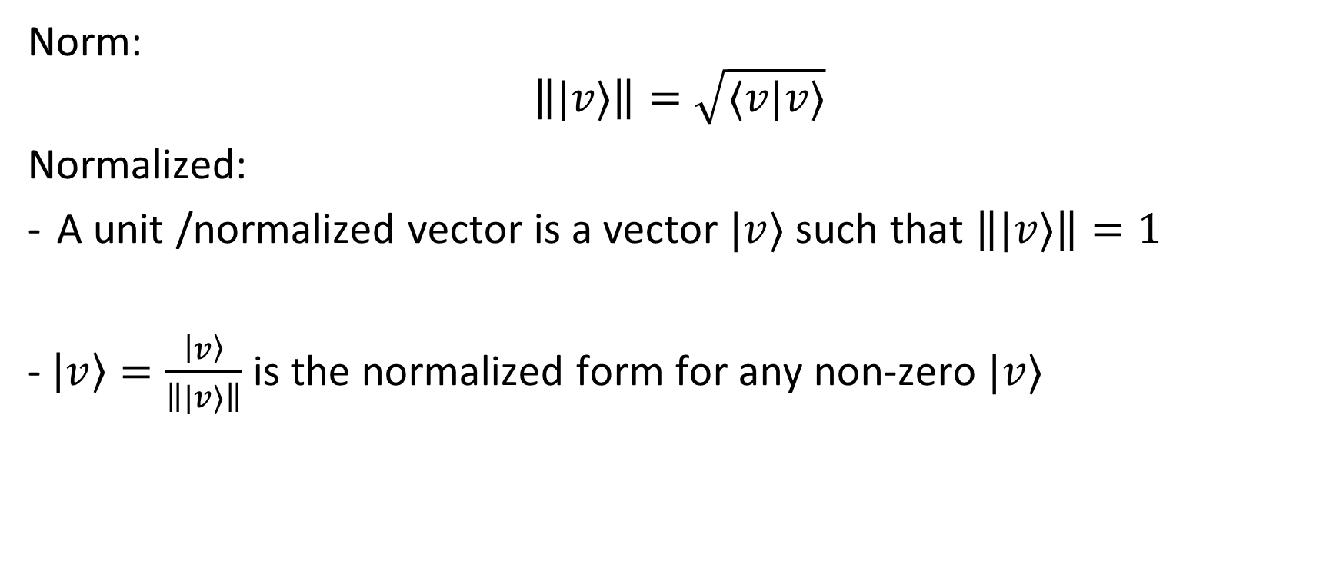
1.4. Inner product: Norm
Norm:
$$\left\||v⟩\right\|=\sqrt{⟨v|v⟩}$$
Normalized:
A unit /normalized vector is a vector $|v⟩$ such that $\left\||v⟩\right\|=1$
- $\left|v\right\rangle =\frac{\left|v\right\rangle }{\left\||v⟩\right\|}$ is the normalized form for any non-zero $|v⟩$

Slide 14
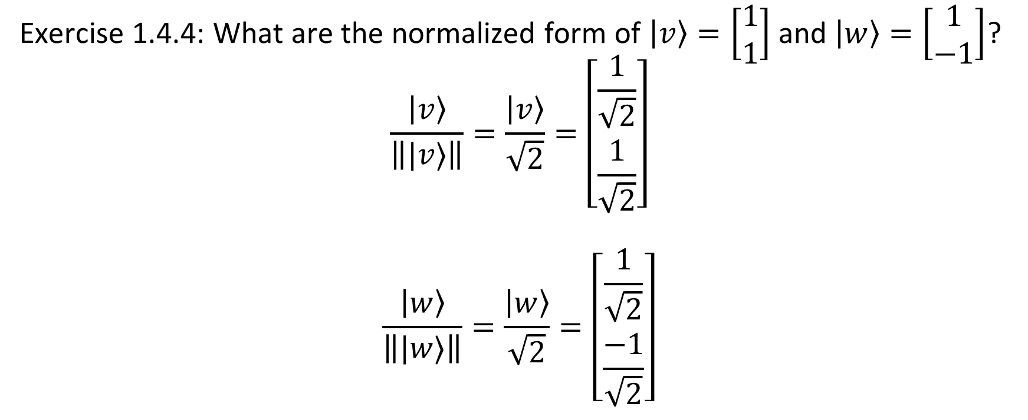
1.4. Inner product: Norm
Exercise 1.4.4: What are the normalized form of $\left|v\right\rangle =\left[\begin{matrix}1 \\ 1\end{matrix}\right]$ and $\left|w\right\rangle =\left[\begin{matrix}1 \\ −1\end{matrix}\right]$?
$$\frac{\left|v\right\rangle }{\left\||v⟩\right\|}=\frac{\left|v\right\rangle }{\sqrt{2}}=\left[\begin{matrix}\frac{1}{\sqrt{2}} \\ \frac{1}{\sqrt{2}}\end{matrix}\right]$$
$$\frac{\left|w\right\rangle }{\left\||w⟩\right\|}=\frac{\left|w\right\rangle }{\sqrt{2}}=\left[\begin{matrix}\frac{1}{\sqrt{2}} \\ \frac{−1}{\sqrt{2}}\end{matrix}\right]$$

Slide 15
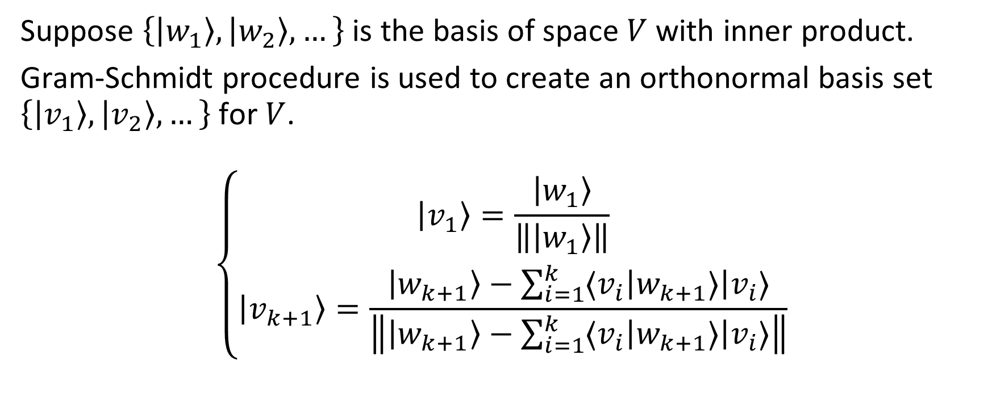
1.4. Inner product: Gram-Schmidt procedure
Suppose $\left\{\left|w_{1}\right\rangle ,\left|w_{2}\right\rangle ,…\right\}$ is the basis of space $V$ with inner product.
Gram-Schmidt procedure is used to create an orthonormal basis set $\left\{\left|v_{1}\right\rangle ,\left|v_{2}\right\rangle ,…\right\}$ for $V$.
$$\left\{\begin{aligned}\left|v_{1}\right\rangle =\frac{\left|w_{1}\right\rangle }{\left\|\left|w_{1}\right\rangle \right\|} \\ \left|v_{k+1}\right\rangle =\frac{\left|w_{k+1}\right\rangle −\sum_{i=1}^{k}{⟨v_{i}\left|w_{k+1}⟩\right|v_{i}⟩}}{\left\|\left|w_{k+1}\right\rangle −\sum_{i=1}^{k}{⟨v_{i}\left|w_{k+1}⟩\right|v_{i}⟩}\right\|}\end{aligned}\right.$$

Slide 16
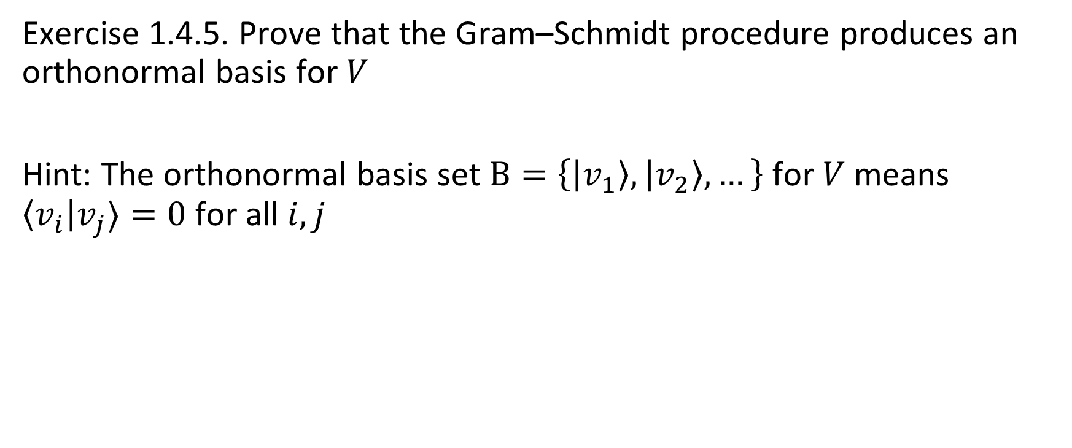
1.4. Inner product: Gram-Schmidt procedure
Exercise 1.4.5. Prove that the Gram–Schmidt procedure produces an orthonormal basis for $V$
Hint: The orthonormal basis set $B=\left\{\left|v_{1}\right\rangle ,\left|v_{2}\right\rangle ,…\right\}$ for $V$ means $\left\langle v_{i}\right|v_{j}⟩=0$ for all $i,j$

Slide 17
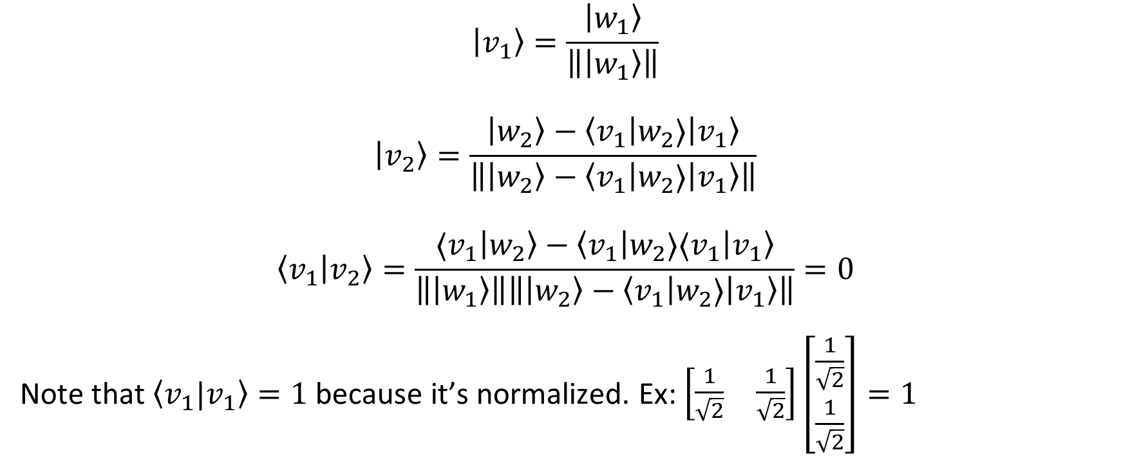
1.4. Inner product: Gram-Schmidt procedure
$$\left|v_{1}\right\rangle =\frac{\left|w_{1}\right\rangle }{\left\|\left|w_{1}\right\rangle \right\|}$$
$$\left|v_{2}\right\rangle =\frac{\left|w_{2}\right\rangle −\left\langle v_{1}\left|w_{2}⟩\right|v_{1}\right\rangle }{\left\|\left|w_{2}\right\rangle −\left\langle v_{1}\left|w_{2}⟩\right|v_{1}\right\rangle \right\|}$$
$$\left\langle v_{1} | v_{2}\right\rangle =\frac{⟨v_{1}\left|w_{2}\right\rangle −\left\langle v_{1}\left|w_{2}⟩⟨v_{1}\right|v_{1}\right\rangle }{\left\|\left|w_{1}\right\rangle \right\|\left\|\left|w_{2}\right\rangle −\left\langle v_{1}\left|w_{2}⟩\right|v_{1}\right\rangle \right\|}=0$$
Note that $\left\langle v_{1}|v_{1}\right\rangle =1$ because it’s normalized. Ex: $\left[\begin{matrix}\frac{1}{\sqrt{2}} & \frac{1}{\sqrt{2}}\end{matrix}\right]\left[\begin{matrix}\frac{1}{\sqrt{2}} \\ \frac{1}{\sqrt{2}}\end{matrix}\right]=1$

Slide 18
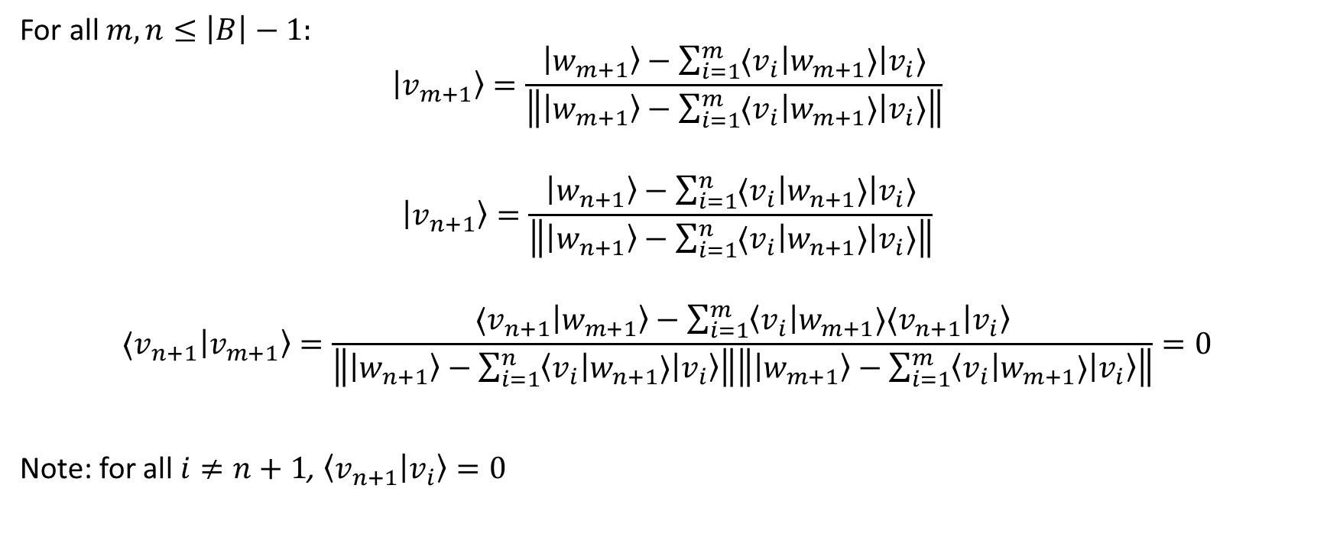
1.4. Inner product: Gram-Schmidt procedure
For all $m,n≤\left|B\right|−1:$
$$\left|v_{m+1}\right\rangle =\frac{\left|w_{m+1}\right\rangle −\sum_{i=1}^{m}{⟨v_{i}\left|w_{m+1}⟩\right|v_{i}⟩}}{\left\|\left|w_{m+1}\right\rangle −\sum_{i=1}^{m}{⟨v_{i}\left|w_{m+1}⟩\right|v_{i}⟩}\right\|}$$
$$\left|v_{n+1}\right\rangle =\frac{\left|w_{n+1}\right\rangle −\sum_{i=1}^{n}{⟨v_{i}\left|w_{n+1}⟩\right|v_{i}⟩}}{\left\|\left|w_{n+1}\right\rangle −\sum_{i=1}^{n}{⟨v_{i}\left|w_{n+1}⟩\right|v_{i}⟩}\right\|}$$
$$⟨v_{n+1}\left|v_{m+1}\right\rangle =\frac{⟨v_{n+1}\left|w_{m+1}\right\rangle −\sum_{i=1}^{m}{\left\langle v_{i}\left|w_{m+1}⟩⟨v_{n+1}\right|v_{i}\right\rangle }}{\left\|\left|w_{n+1}\right\rangle −\sum_{i=1}^{n}{\left\langle v_{i}\left|w_{n+1}⟩\right|v_{i}\right\rangle }\right\|\left\|\left|w_{m+1}\right\rangle −\sum_{i=1}^{m}{\left\langle v_{i}\left|w_{m+1}⟩\right|v_{i}\right\rangle }\right\|}=0$$
Note: for all $i≠n+1$, $\left\langle v_{n+1} | v_{i}\right\rangle =0$

Slide 19
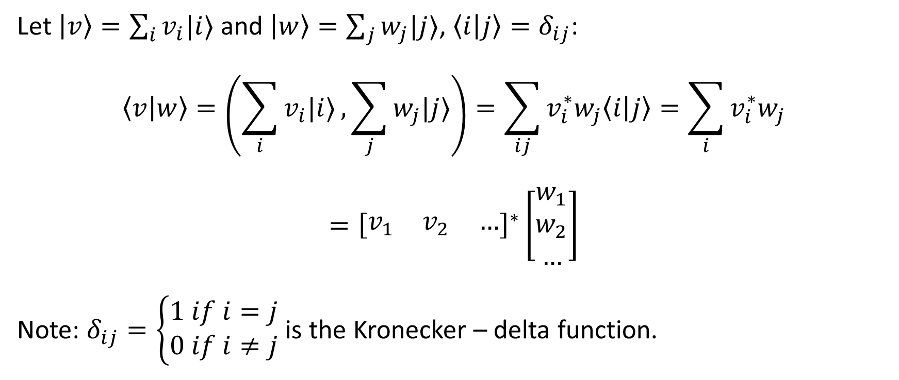
1.4. Inner product: Hilbert space / matrix presentation
Let $\left|v\right\rangle =\sum_{i}{v_{i}|i⟩}$ and $\left|w\right\rangle =\sum_{j}{w_{j}|j⟩}$, $\left\langle i | j\right\rangle =δ_{ij}$:
$$\left\langle v | w\right\rangle =\left(\sum_{i}{v_{i}|i⟩},\sum_{j}{w_{j}|j⟩}\right)=\sum_{ij}{v_{i}^{∗}w_{j}\left\langle i | j\right\rangle =\sum_{i}{v_{i}^{∗}w_{j}}}$$
$$={\left[\begin{matrix}v_{1} & v_{2} & …\end{matrix}\right]}^{∗}\left[\begin{matrix}w_{1} \\ w_{2} \\ …\end{matrix}\right]$$
Note: $δ_{ij}=\left\{\begin{aligned}1 if i=j \\ 0 if i≠j\end{aligned}\right.$ is the Kronecker – delta function.

Slide 20
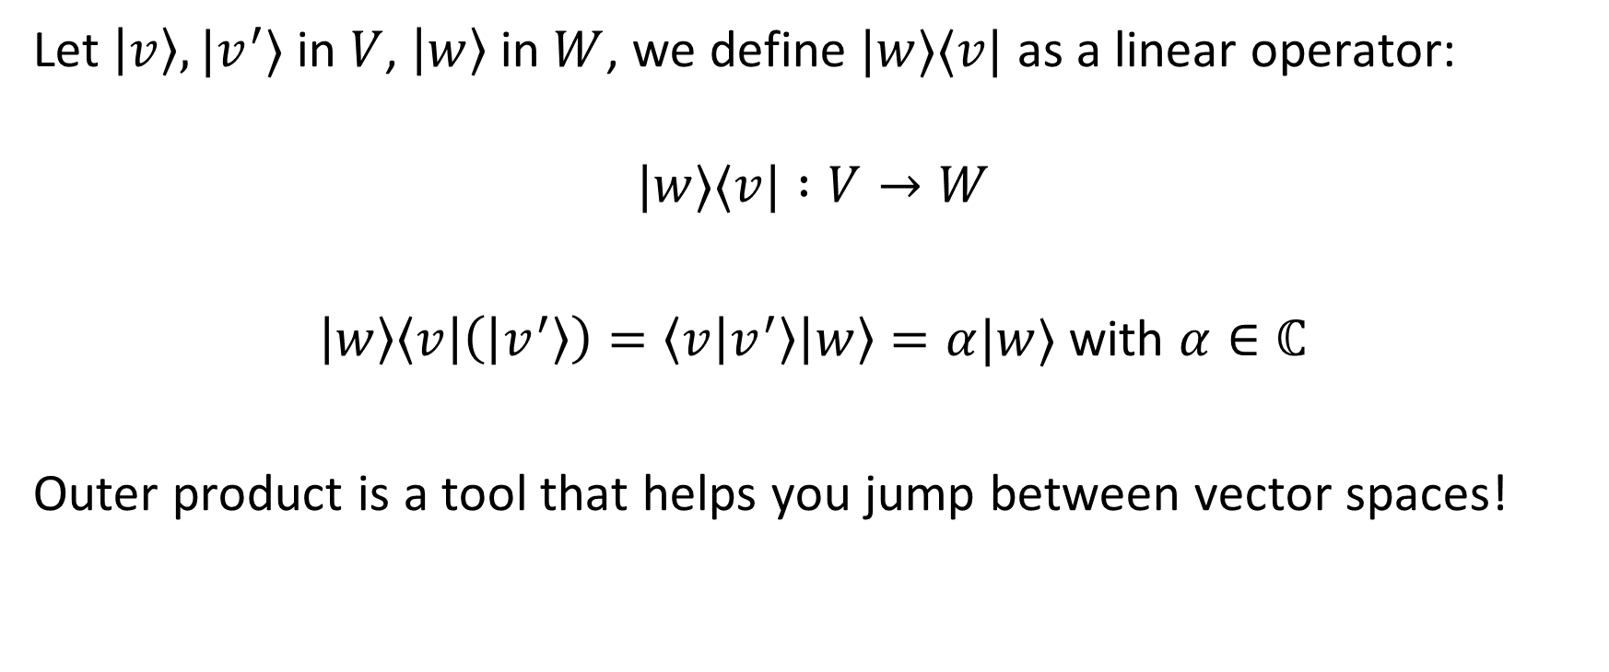
1.4. Outer product
Let $\left|v\right\rangle ,|v^{′}⟩$ in $V$, $\left|w\right\rangle$ in $W$, we define $|w⟩⟨v|$ as a linear operator:
$$|w⟩⟨v| :V→W$$
$\left|w\right\rangle \left\langle v\left|\left(\left|v^{′}\right\rangle \right)=\left\langle v | v^{′}\right\rangle \right|w\right\rangle =α|w⟩$ with $α∈ℂ$
Outer product is a tool that helps you jump between vector spaces!

Slide 21
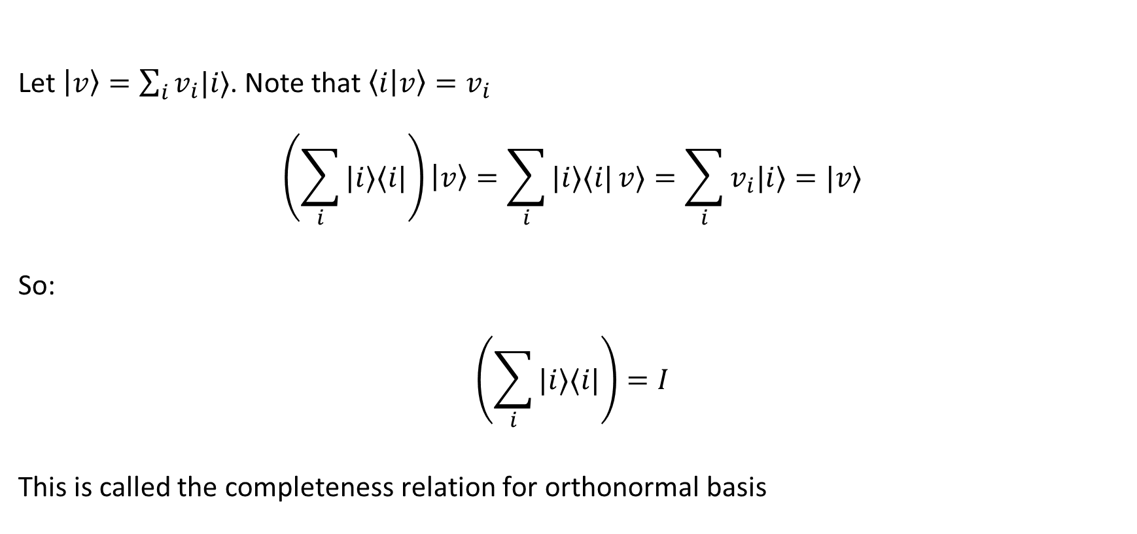
1.4. Outer product
Let $\left|v\right\rangle =\sum_{i}{v_{i}|i⟩}$. Note that $\left\langle i | v\right\rangle =v_{i}$
$$\left(\sum_{i}{|i⟩⟨i|}\right)\left|v\right\rangle =\sum_{i}{|i⟩⟨i|}v⟩=\sum_{i}{v_{i}|i⟩}=|v⟩$$
So:
$$\left(\sum_{i}{|i⟩⟨i|}\right)=I$$
This is called the completeness relation for orthonormal basis
Notes:
One application ofthe completeness relation is to give a means for representing any operator in the outer product notation

Slide 22

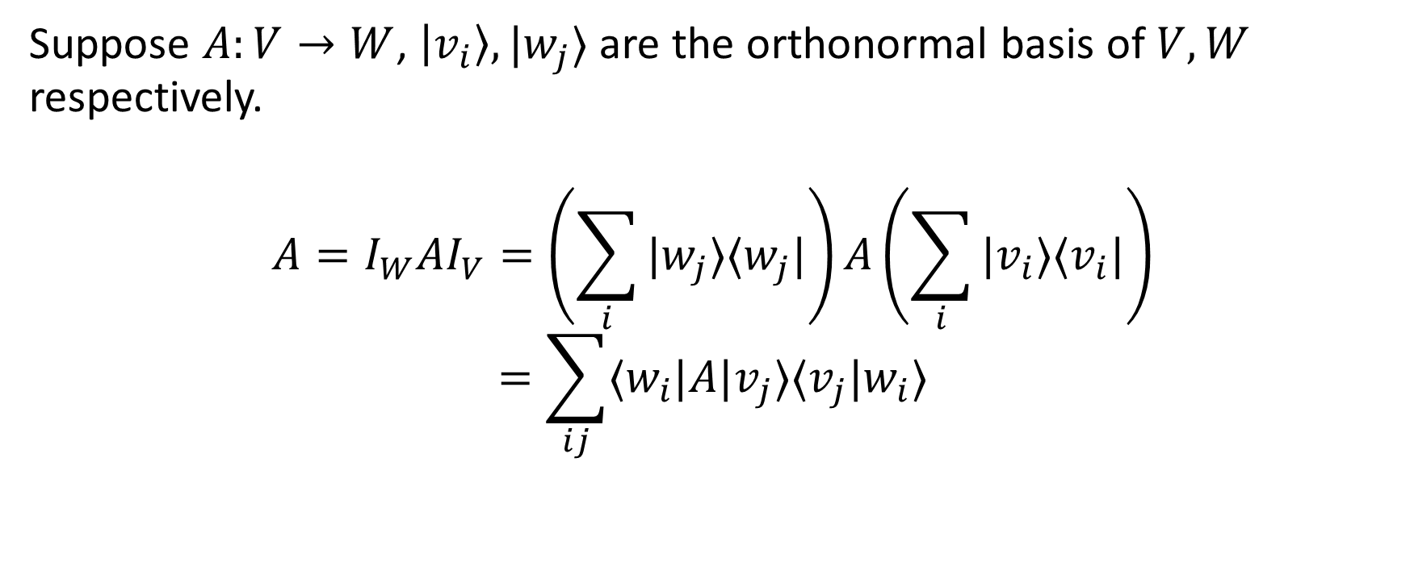
1.4. Outer product
Suppose $A:V→W$, $\left|v_{i}\right\rangle ,|w_{j}⟩$ are the orthonormal basis of $V,W$ respectively.
$$A=I_{W}AI_{V}=\left(\sum_{i}{|w_{j}⟩⟨w_{j}|}\right)A\left(\sum_{i}{|v_{i}⟩⟨v_{i}|}\right)$$
$$=\sum_{ij}{⟨w_{i}|A|v_{j}⟩⟨v_{j}|w_{i}⟩}$$
$$A_{ji}$$

Slide 23
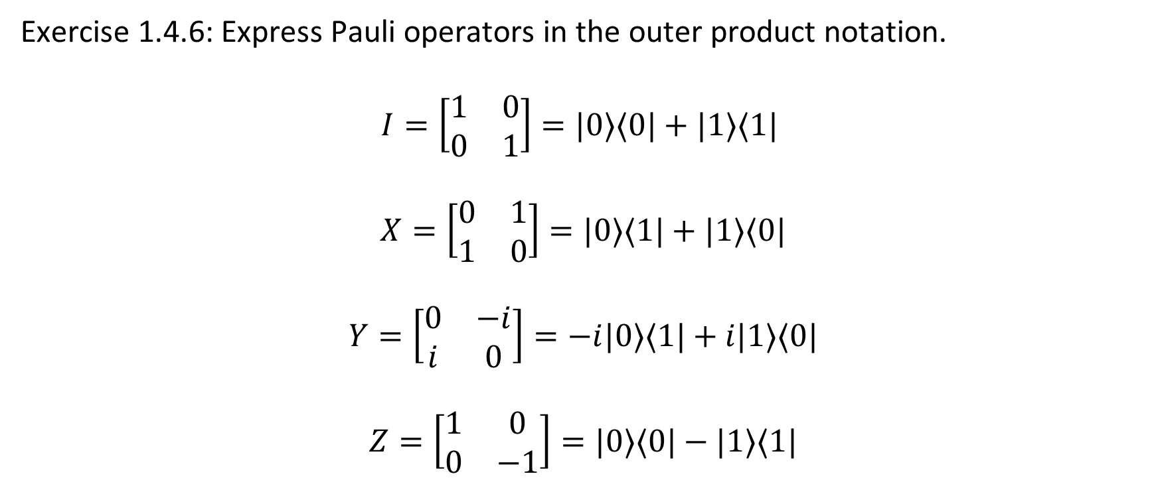
1.4. Outer product
Exercise 1.4.6: Express Pauli operators in the outer product notation.
$$I=\left[\begin{matrix}1 & 0 \\ 0 & 1\end{matrix}\right]=|0⟩⟨0|+|1⟩⟨1|$$
$$X=\left[\begin{matrix}0 & 1 \\ 1 & 0\end{matrix}\right]=|0⟩⟨1|+|1⟩⟨0|$$
$$Y=\left[\begin{matrix}0 & −i \\ i & 0\end{matrix}\right]=−i|0⟩⟨1|+i|1⟩⟨0|$$
$$Z=\left[\begin{matrix}1 & 0 \\ 0 & −1\end{matrix}\right]=|0⟩⟨0|−|1⟩⟨1|$$

Slide 24
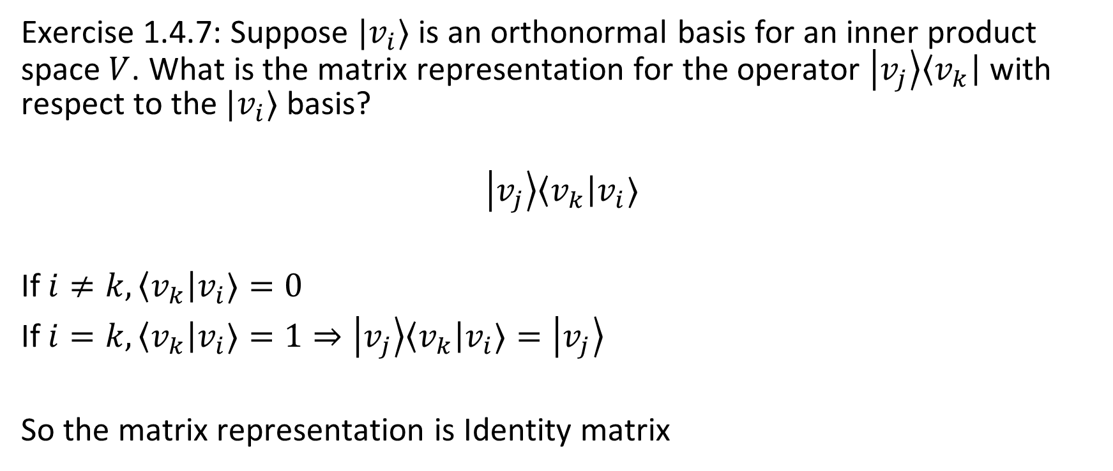
1.4. Outer product
Exercise 1.4.7: Suppose $|v_{i}⟩$ is an orthonormal basis for an inner product space $V$. What is the matrix representation for the operator $\left|v_{j}\right\rangle \left\langle v_{k}\right|$ with respect to the $|v_{i}⟩$ basis?
$$\left|v_{j}\right\rangle \left\langle v_{k}\right|v_{i}⟩$$
If $i≠k,\left\langle v_{k}\right|v_{i}⟩=0$
If $i=k,\left\langle v_{k}\right|v_{i}⟩=1⇒\left|v_{j}\right\rangle \left\langle v_{k}\right|v_{i}⟩=\left|v_{j}\right\rangle$
So the matrix representation is Identity matrix

Slide 25
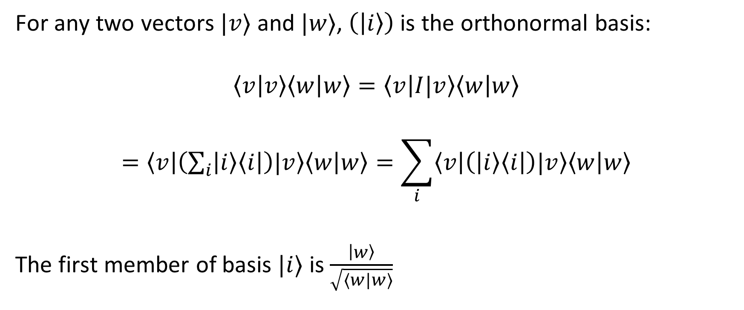
*The Cauchy-Schwarz inequality
For any two vectors $|v⟩$ and $|w⟩$, $\left(\left|i\right\rangle \right)$ is the orthonormal basis:
$$\left\langle v | v\right\rangle \left\langle w | w\right\rangle =\left\langle v | I|v\right\rangle \left\langle w | w\right\rangle$$
$$=\left\langle v | \left(\sum_{i}{\left|i\right\rangle \left\langle i\right|}\right)|v\right\rangle \left\langle w | w\right\rangle =\sum_{i}{\left\langle v | \left(\left|i\right\rangle \left\langle i\right|\right)|v\right\rangle \left\langle w | w\right\rangle }$$
The first member of basis $|i⟩$ is $\frac{\left|w\right\rangle }{\sqrt{⟨w|w⟩}}$

Slide 26
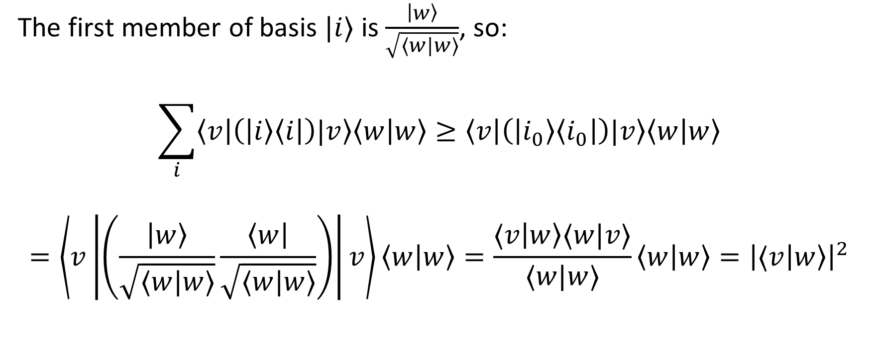
*The Cauchy-Schwarz inequality
The first member of basis $|i⟩$ is $\frac{\left|w\right\rangle }{\sqrt{⟨w|w⟩}}$, so:
$$\sum_{i}{\left\langle v | \left(\left|i\right\rangle \left\langle i\right|\right)|v\right\rangle \left\langle w | w\right\rangle }≥\left\langle v | \left(\left|i_{0}\right\rangle \left\langle i_{0}\right|\right)|v\right\rangle \left\langle w | w\right\rangle$$
$$=\left\langle v\left|\left(\frac{\left|w\right\rangle }{\sqrt{⟨w|w⟩}}\frac{\left\langle w\right|}{\sqrt{⟨w|w⟩}}\right)\right|v\right\rangle \left\langle w | w\right\rangle =\frac{⟨v\left|w\right\rangle ⟨w|v⟩}{⟨w|w⟩}\left\langle w | w\right\rangle ={\left|⟨v\left|w\right\rangle \right|}^{2}$$

Slide 27

*The Cauchy-Schwarz inequality
$$\left\langle v | v\right\rangle \left\langle w | w\right\rangle ≥{\left|⟨v\left|w\right\rangle \right|}^{2}$$
The equality occurs iff $\left|v\right\rangle =z|w⟩$ with $z∈ℂ$
Prove:
$$\left\langle v | v\right\rangle \left\langle w | w\right\rangle =z^{∗}z{\left|\left\langle w | w\right\rangle \right|}^{2}={\left|z\right|}^{2}{\left|\left\langle w | w\right\rangle \right|}^{2}$$

Slide 28
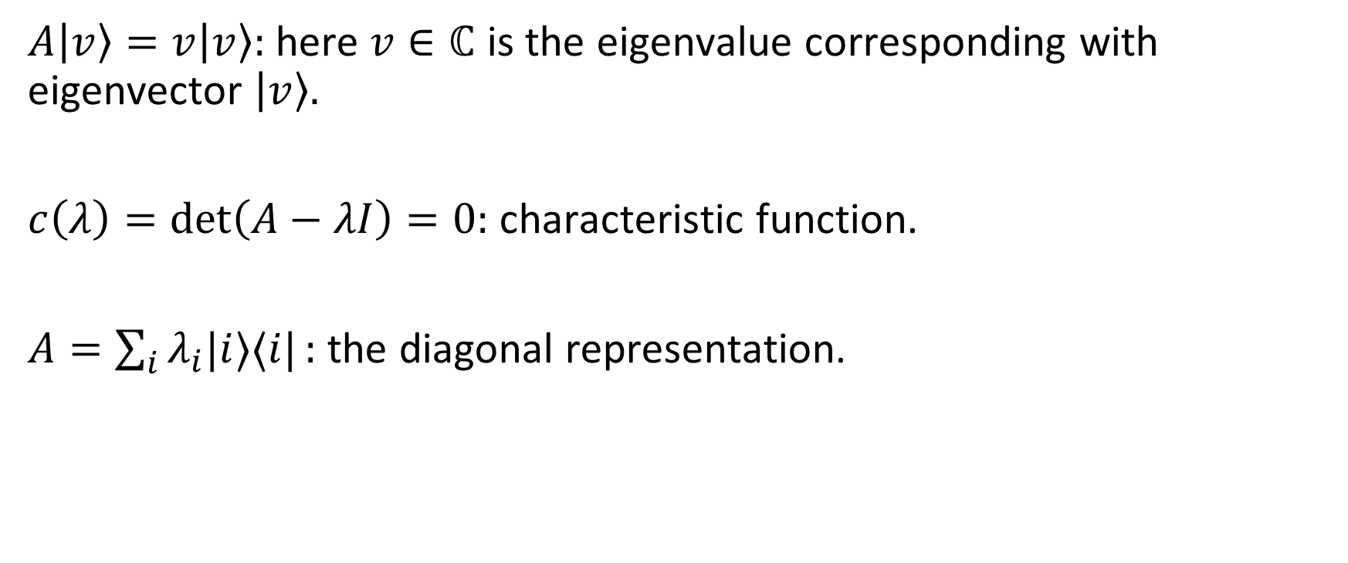
1.5. Eigenvalue & eigenvector
$A\left|v\right\rangle =v\left|v\right\rangle :$ here $v∈ℂ$ is the eigenvalue corresponding with eigenvector $\left|v\right\rangle .$
$c\left(λ\right)=\det\left(A−λI\right)=0:$ characteristic function.
$A=\sum_{i}{λ_{i}|i⟩⟨i|}:$ the diagonal representation.

Slide 29
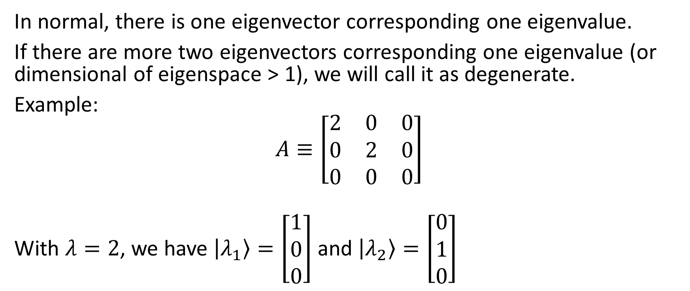
1.5. Eigenvalue & eigenvector
In normal, there is one eigenvector corresponding one eigenvalue.
If there are more two eigenvectors corresponding one eigenvalue (or dimensional of eigenspace > 1), we will call it as degenerate.
Example:
$$A≡\left[\begin{matrix}2 & 0 & 0 \\ 0 & 2 & 0 \\ 0 & 0 & 0\end{matrix}\right]$$
With $λ=2$, we have $\left|λ_{1}\right\rangle =\left[\begin{matrix}1 \\ 0 \\ 0\end{matrix}\right]$ and $\left|λ_{2}\right\rangle =\left[\begin{matrix}0 \\ 1 \\ 0\end{matrix}\right]$

Slide 30

1.5. Eigenvalue & eigenvector
Exercise 1.5.1: Find the eigenvectors, eigenvalues, and diagonal representations of the Pauli matrices $X,Y$ and $Z$.

Slide 31

1.5. Eigenvalue & eigenvector
Exercise 1.5.2: Prove that the matrix
$$A=\left[\begin{matrix}1 & 0 \\ 1 & 1\end{matrix}\right]$$
is not diagonalizable.

Slide 32
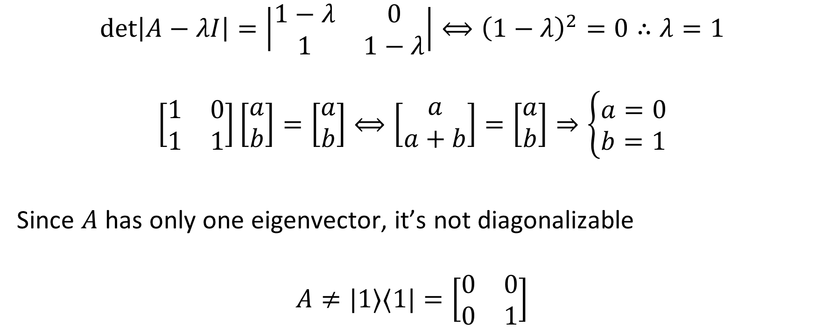
1.5. Eigenvalue & eigenvector
$$\det\left|A−λI\right|=\left|\begin{matrix}1−λ & 0 \\ 1 & 1−λ\end{matrix}\right|⟺{\left(1−λ\right)}^{2}=0∴λ=1$$
$$\left[\begin{matrix}1 & 0 \\ 1 & 1\end{matrix}\right]\left[\begin{matrix}a \\ b\end{matrix}\right]=\left[\begin{matrix}a \\ b\end{matrix}\right]⟺\left[\begin{matrix}a \\ a+b\end{matrix}\right]=\left[\begin{matrix}a \\ b\end{matrix}\right]⇒\left\{\begin{aligned}a=0 \\ b=1\end{aligned}\right.$$
Since $A$ has only one eigenvector, it’s not diagonalizable
$$A≠|1⟩⟨1|=\left[\begin{matrix}0 & 0 \\ 0 & 1\end{matrix}\right]$$

Slide 33

1.6. Adjoint and Hermitian
$$\left|v\right\rangle ≡{\left\langle v\right|}^{†}$$
$${\left(AB\right)}^{†}=B^{†}A^{†}$$
$${\left(A | v⟩\right)}^{†}=⟨v|A^{†}$$
$$\left(\left|v\right\rangle ,A|w⟩\right)=\left(A^{†}\left|v\right\rangle ,\left|w\right\rangle \right)$$
Exercise 1.6.1: Prove that ${\left(\left|w\right\rangle \left\langle v\right|\right)}^{†}=\left(|v⟩⟨w|\right)$

